Slide 1
Server Threads and Synchronization
Windows Sockets Programming

Slide 2
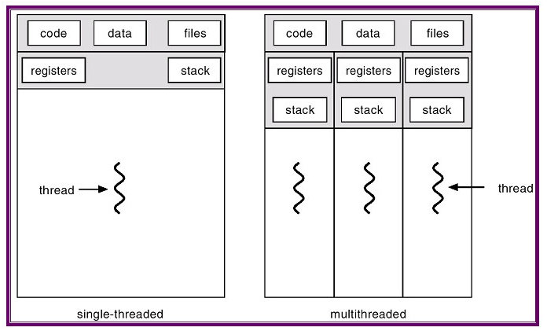
Thread and Synchronization
Operating system
Resource management
CPU, Memory, I/O
CPU(register)-cache-memory-HDD : paging (4KB)
Process scheduling
Time slicing
Real-time
Multi-Tasking
Process-Thread
Program running unit
Context switching

Slide 3
Thread and Synchronization
Context switching
Register set
Kernel stack
User stack
Socket
Locked pages
Send, recv buffer (8kB)
Non-paged pool (2kB)
Status, address
Total ¼ memory size
Tradeoff between number of thread and performance

Slide 4
Thread and Synchronization
CreateThread(
LPSECURITY_ATTRIBUTES lpThreadAttributes, // determines whether the returned handle can
be inherited by child processes
DWORD dwStackSize, // The default stack reservation size used by the linker is 1 MB
LPTHREAD_START_ROUTINE lpStartAddress, // A pointer to the application-defined function
LPVOID lpParameter, // A pointer to a variable to be passed to the thread
DWORD dwCreationFlags, // The thread runs immediately after creation.
LPDWORD lpThreadId // A pointer to a variable that receives the thread identifier
);
handleThread[i] = ::CreateThread( 0, 0, ThreadRunner, &array[i], 0, 0 );

Slide 5
Thread and Synchronization
DWORD __stdcall ThreadRunner( LPVOID parameter ){
int* argument;
int count=3;
argument = ( int* )parameter;
while( count-- > 0 )
printf( "I'm %d Thread !!\n", *argument );
return 0;
}
void main(){
HANDLE handleThread[5];
int array[5] = { 0, }, i;
for( i = 0 ; i < 5 ; i++ ){
array[i] = i;
handleThread[i] = ::CreateThread( 0, 0, ThreadRunner, &array[i], 0, 0 );
}
for( i = 0 ; i < 5 ; i++ )
printf( "I'm Main thread !!\n" );
::WaitForMultipleObjects( 5, handleThread, TRUE, INFINITE );
}

Slide 6
Thread and Synchronization
Synchronization
Static or global variables
void TestThread::run()
{
testFunc();
}
void testFunc()
{
if(obj!=NULL){
printf(“%d”, obj->count);
delete obj;
obj=0;
}
}

Slide 7
Thread and Synchronization
Synchronization
Critical section
Event
Mutex
Semaphore

Slide 8
Thread and Synchronization
Critical section
CRITICAL_SECTION cs;
InitializeCriticalSection( &cs );
EnterCriticalSection(&cs );
// common or shared variable handling
LeaveCriticalSection(&cs );

Slide 9
Thread and Synchronization
Event
CreateEvent(lpEventAttribute, bManualReset, bInitialState, lpName);
HANDLE hEvent=CreateEvent(0, FALSE, FALSE, 0);
void Thread1()
{
…
SetEvent(hEvent);
…
}
void Thread2()
{
...
if(WaitForSingleObject(hEvent, INFINITE) == WAIT_OBJECT_O)
…
}

Slide 10
Thread and Synchronization
Mutex – interprocess operation
CreateMutex function to create a mutex object.
The thread can request immediate ownership of the mutex object as well as specify a name for the mutex object.
If the mutex object already exists, GetLastError returns ERROR_ALREADY_EXISTS
ReleaseMutex
HANDLE hMutex = CreateMutex ( NULL, // No security descriptor FALSE, // Mutex object not owned TEXT("NameOfMutexObject")); // Object name
WaitForSingleObject(hMutex , INFINITE);
ReleaseMutex (hMutex);

Slide 11
Thread and Synchronization
Interlocked functions
The interlocked functions provide a simple mechanism for synchronizing access to a variable that is shared by multiple threads.
InterlockedIncrement
Increments (increases by one) the value of the specified 32-bit variable as an atomic operation.
InterlockedDecrement
InterlockedExchange
Problems in synchronization
Dead lock
Bottleneck

Slide 12
Thread and Synchronization
WaitForMultipleObjects
HANDLE handleThread[MAX_TREAD];
handleThread[k]=CreateThread(NULL, 0, NetReceive, (void *) socketConnect[k], THREAD_PRIORITY_NORMAL, NULL);
WaitForMultipleObjects(
DWORD nCount,
CONST HANDLE *lpHandles,
BOOL bWaitAll,
DWORD dwMilliseconds );
WaitForMultipleObjects( MAX_TREAD, handleThread, TRUE, INFINITE );

Slide 13
Exercise
Add synchronize function to prevent Printf error
NGP 05-MultiThreadingSynch folder
CRITICAL_SECTION cs;
::InitializeCriticalSection( &cs );
::EnterCriticalSection( &cs );
::LeaveCriticalSection( &cs );
TCP client (NGP 05-TCPmultiExeClientThread)
Modify “tcpclientThread.cpp” to apply multiple client connections
Separate the “recv()” function using thread
Synchronize main() and threads to finish gracefully
::WaitForMultipleObjects( MAX_CLIENT, handleThread, TRUE, INFINITE );
Add “special code” to indicate the end of connection

Slide 14
Quiz
TCP client (NGP 05-TCPmultiExeClientThread)
Modify “tcpclientThread.cpp” to apply multiple client connections
Separate the “recv()” function using thread
naver.com ip address = 125.209.222.141
daum.net ip address = 211.231.99.17
Quiz – make a client
Connect to the server( ip= 223.130.195.200, port=80)
Send the message “Test.\n\n”
Print all received messages

Slide 15
Quiz
Quiz – make a client
Connect to the server( daum.net, port=80)
Send the message “Test.\n\n” and Print all messages
Connected to server ...
Thread start...
SND 8> Test.
Server Connection Closed !
RECV 124> 127 bytes: <!DOCTYPE HTML PUBLIC "-//IETF//DTD HTML 2.0//EN">
<html><head>
<title>302 Found</title>
</head><body>
<h1>Found</h1>
<p>The do儆儆?陷즶?j3v|
RECV 124> 99 bytes: cument has moved <a href="http://status.daum.net/error/error
403.html">here</a>.</p>
</body></html>
dy>
<h1>Found</h1>
<p>The do儆儆?陷즶?j3v|

